Slide 1
Day 1 Afternoon: Understanding HCI Contributions
Prof. Shengdong Zhao

Slide 2
A brief history of HCI contribution (slide 2-9, ~5 mins)

Slide 3
What is research contribution in HCI?
This question actually bothers the field for many years
Notes:
Researchers in the field have some ideas about it, but there was never a consensus. Different school of thoughts appears. Paper accepted based on who is in the committee and their tastes.

Slide 4
1996 - Age of rough categorizations
Paper types
Experience papers
System papers

Slide 5
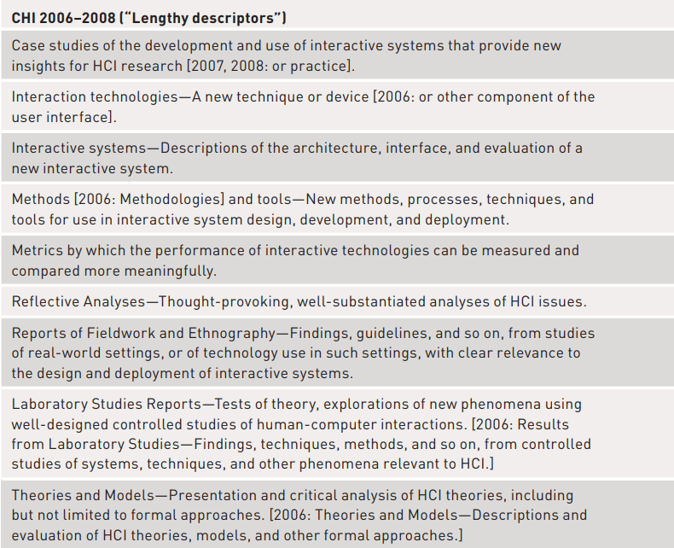
2006 - 2008 - Elaboration of the list of things

Slide 6
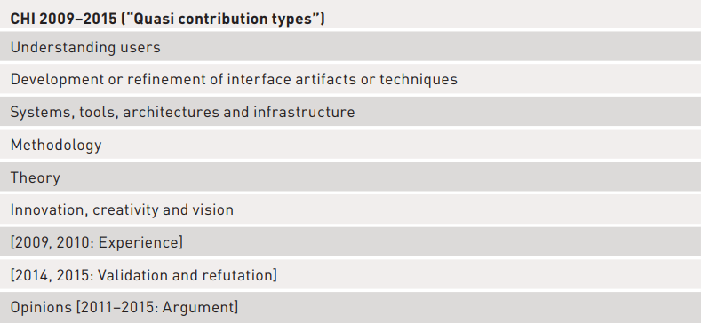
2009 - 2015 - A refined list

Slide 7
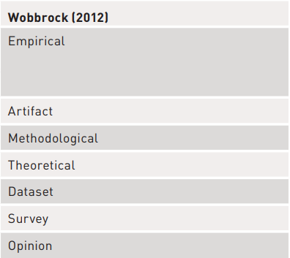
2012 - An attempt to formalize this list
Remember this as
Wob’12

Slide 8
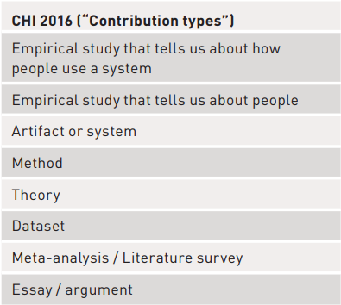
2016 - official use of the list

Slide 9
This is one step forward, yet it also raises many questions
Why these 7 types?
Is this a complete list?
What’s the relationship among the different types?
Are they parallel concepts or nodes at different levels of a knowledge structure?
…

Slide 10
Introducing the 1st top-down framework (2016)

Slide 11
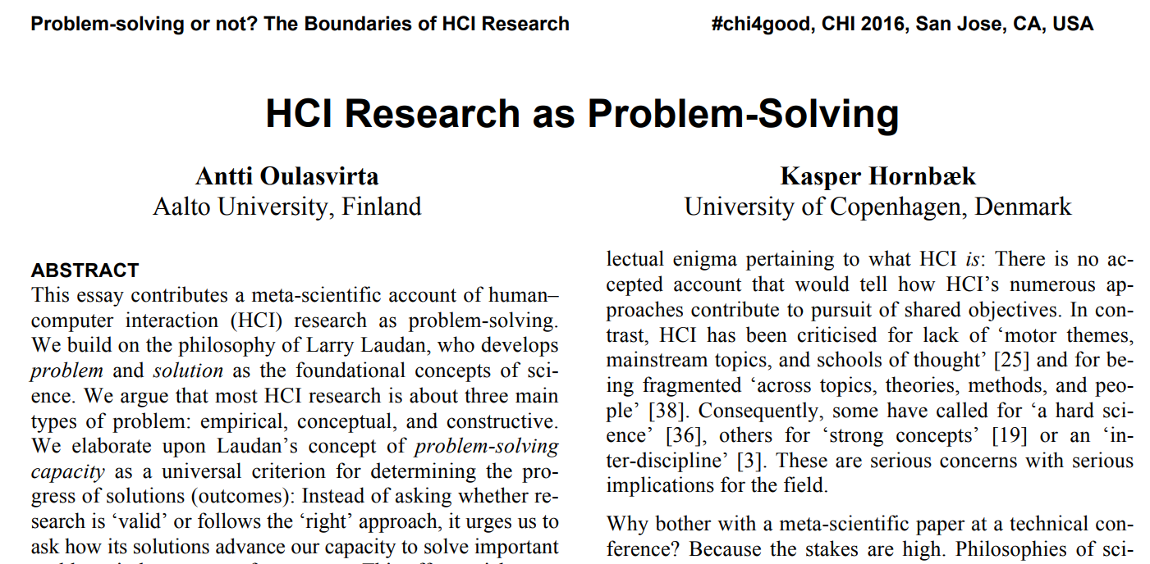
Remember this as
O&H’16

Slide 12
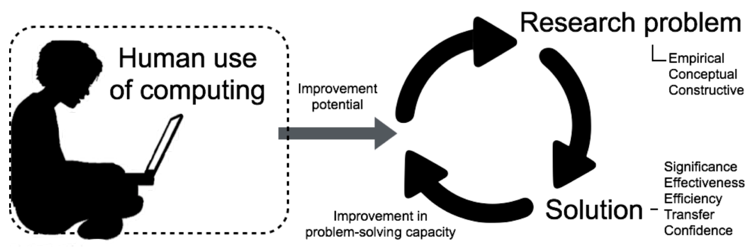
Which is HCI research and its “scientific progress”?
HCI research is defined as finding solutions to research problems that can improve our problem-solving capacity
The “scientific progress” of HCI

Slide 13
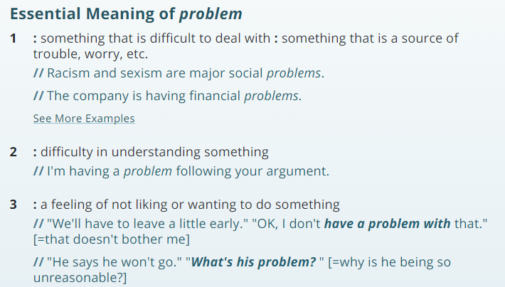
What is a research problem? (5 mins)
Dictionary
Definition

Slide 14
What is a research problem?
Definition in the HCI research context [O&H’16]
Inabilities and absences occurring in knowledge or constructive solutions
A problem ~= a knowledge gap
Example:
Problem: lack of the understanding of “how colour schemes on a web page affect user experience”

Slide 15
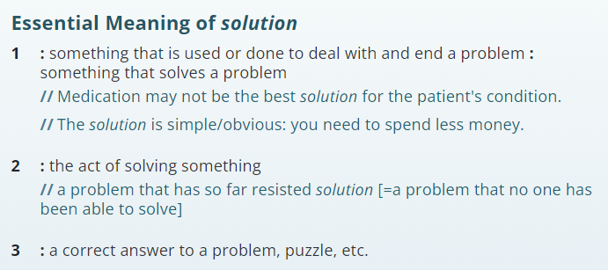
What is a solution?
Dictionary
Definition

Slide 16
What is a research solution?
Definition in the HCI research context [O&H’16]
Knowledge that improves our problem solving capacity for that particular problem
A problem ~= a knowledge gap
A solution ~= new knowledge that helps to fill the gap
Example:
Problem: lack of the understanding of “how colour schemes on a web page affect user experience”
Solution: new knowledge of how warm vs. cold colours affect user experience in browsing the website

Slide 17

Interactive Time (5 mins)
Please go to Pollev.com/szhao168
(question 1, 2, 3)

Slide 18
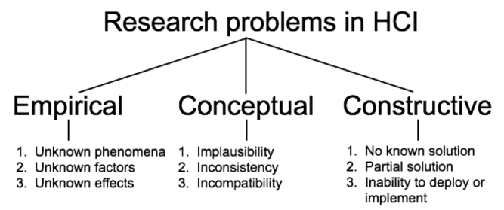
What are the main contribution types in HCI?

Slide 19
What is empirical research contribution?
[O&H’16] Empirical research is aimed at creating or elaborating descriptions of real-world phenomena related to human use of computing
Unknown phenomena
Unknown factors
Unknown effects
[Wob’12] Empirical findings are based on observation and data-gathering
These findings come from variety of sources
Experiments, user tests, field observations, interviews, surveys, focus groups, diaries, ethnographies, sensors, log files, etc.
Purpose
Form

Slide 20
Example of empirical research in HCI
Examples of empirical research papers
[O&H’16]
[Phenomenon] A field study of exploratory learning strategies
[Factor] Distance matters
[Effect] Untangling the usability of fisheye menus
[Wob’12]
[Interview study] Social use of computer-mediated communication by adults on the autism spectrum
[Diary study] A diary study of task switching and interruptions
[Lab experiment] The performance of touch screen soft buttons
[Crowdsourcing study] How deceptive are deceptive visualizations …
[Qualitative field study] Organizational obstacles to interface design and development …

Slide 21
Interactive Time (3 mins)
Please go to Pollev.com/szhao168 (questions 4)

Slide 22
What is conceptual/theoretical research contribution?
[O&H’16] Definition: Work on a conceptual research problem is aimed at explaining previously unconnected phenomena occurring in interaction.
implausibility
inconsistency
incompatibility
[O&H’16] Examples: Theories, concepts, methods, principles, and models
[Wob’12] Definition: Theories should be testable and falsifiable; if they are not, they do not qualify as scientific theories
[Wob’12] Examples: consist of new or improved concepts, definitions, models, principles, or frameworks.

Slide 23
Unfortunately, Wob’12’s definition has a serious issue

Slide 24
Contradiction in its definition
[Wob’12] Theories should be testable and falsifiable; if they are not, they do not qualify as scientific theories
Examples of theoretical research papers
[Wob’12]
[Thought framework] Making sense of sensing systems: Five questions …
[Design space] The design space of input devices
[Conceptual model] A conceptual framework of and for CSCW
[Design criteria] Envisioning systemic effects on persons and society …
[Qualitative model] An error model for pointing based on Fitts law
Question: how many of the above “theories” are testable and falsifiable?

Slide 25
What’s testable and falsifiable?
This is easiest to show by example. Let's take a hypothesis like: "Abraham Lincoln was the greatest US president". There are three things you can do with a claim like that:
Accept it unconditionally as true.
Reject it unconditionally as false.
Look at Lincoln's presidency and try to determine things that might have made him a great president.
To do the third, you need to:
Find things in Lincoln's presidency that can be measured, so you can compare his acts to the acts of other presidents
Accept both possibilities: that the comparisons you make might show Lincoln was the greatest, and might show that he wasn't.
The first is testability (the capacity to measure and compare), the second is falsifiability (the ability to reject the hypothesis).
Answer provided by Ted Wrigley from Quora

Slide 26
Contradiction in its definition
[Wob’12] Theories should be testable and falsifiable; if they are not, they do not qualify as scientific theories
Examples of theoretical research papers
[Wob’12]
[Thought framework] Making sense of sensing systems: Five questions …
[Design space] The design space of input devices
[Conceptual model] A conceptual framework of and for CSCW
[Design criteria] Envisioning systemic effects on persons and society …
[Qualitative model] An error model for pointing based on Fitts law
Question: how many of these theories are testable and falsifiable?
Question: How do you measure a thought framework, design space, design criteria, etc.

Slide 27
Therefore, [O&H’16] revised it to be the conceptual contributions
This is good, but …

Slide 28
The “magical” three subcategories
[Implausibility] Direct Manipulation Interfaces
[Inconsistency] Implications for design
[Incompatibility] Characterizing computer input with Fitts’ law parameters …
[O&H ‘16]’s definition is problematic: why there are three types of conceptual contributions?
[O&H’16] Conceptual papers include theories, concepts, methods, principles, and models
Questions:
What subcategory is method? Is it implausibility, inconsistency, or incompatibility?
In addition, what’s the difference between inconsistency and incompatibility? Do we really need to distinguish between them?
What exactly is implausibility?

Slide 29
Another way to think about conceptual contributions
Generalizable abstraction that can be applied to a range of phenomena and contexts
This abstraction can be descriptive (qualitative), which can help people to understand certain phenomena better, or it can be predictive (quantitative), which can help people to predict outcomes based on parameters.
It is motivated by three causes:
Lack of explanation
Inconsistency in explanation
Inefficiency in explanation

Slide 30
Explain conceptual contribution in the revised definition
Examples of conceptual research papers
[O&H’16]
[Implausibility] Direct Manipulation Interfaces
descriptive (qualitative) -> to fill in knowledge gap of lack of explanation -> apply to a wide range of DM interfaces
[Inconsistency] Implications for design (privacy as a reciprocal process)
descriptive (qualitative) -> to fill in knowledge gap of lack of explanation -> apply to a wide range of privacy contexts
[Incompatibility] Characterizing computer input with Fitts’ law parameters …
predictive (quantitative) -> to resolve inconsistent explanation -> apply to a wide range of pointing contexts
[Wob’12]
[Thought framework] Making sense of sensing systems: Five questions …
descriptive (qualitative) -> to fill in knowledge gap of lack of explanation -> apply to a wide range of sensing systems
[Design space] The design space of input devices
Question: can you fill in the blank following other examples?
[Conceptual model] A conceptual framework of and for CSCW
descriptive (qualitative) -> to fill in knowledge gap of lack of explanation -> apply to a wide range of CSCW contexts
[Design criteria] Envisioning systemic effects on persons and society …
descriptive (qualitative) -> to fill in knowledge gap of lack of explanation -> apply to a wide range of design scenarios
[Qualitative model] An error model for pointing based on Fitts law
Question: can you fill in the blank following other examples?

Slide 31
Interactive Time (5 mins)
Please go to Pollev.com/szhao168 (question 5, 6)

Slide 32
Empirical vs. conceptual contributions
Examples of empirical research papers
[O&H’16]
[Phenomenon] A field study of exploratory learning strategies
[Factor] Distance matters
[Effect] Untangling the usability of fisheye menus
[Wob’12]
[Interview study] Social use of computer-mediated communication by adults on the autism spectrum
[Diary study] A diary study of task switching and interruptions
[Lab experiment] The performance of touch screen soft buttons
[Crowdsourcing study] How deceptive are deceptive visualizations …
[Qualitative field study] Organizational obstacles to interface design and development …
Examples of conceptual research papers
[O&H’16]
[Implausibility] Direct Manipulation Interfaces
[Inconsistency] Implications for design
[Incompatibility] Characterizing computer input with Fitts’ law parameters …
[Wob’12]
[Thought framework] Making sense of sensing systems: Five questions …
[Design space] The design space of input devices
[Conceptual model] A conceptual framework of and for CSCW
[Design criteria] Envisioning systemic effects on persons and society …
[Qualitative model] An error model for pointing based on Fitts law

Slide 33
What is the difference between Empirical vs Conceptual?
Scope
Empirical contributions are usually specific to certain phenomenon or context while theoretical contributions are generalizable abstractions that can be applied to a broad range of phenomena or contexts
Predictive power
Quantitative models can help to make precise predictions while empirical findings at best can make rough predictions
A is likely better than B, but you don’t know whether it is better for sure, or how much better?

Slide 34
A simple decision tree
Knowledge/finding is predictive?
Yes -> Can apply knowledge/finding to a wide range of contexts?
Yes -> Conceptual
No -> Conceptual
No -> Can apply knowledge/finding to a wide range of contexts?
Yes -> Conceptual
No -> Empirical

Slide 35
What about methods?
Perhaps it can be classified into another category?

Slide 36
What is constructive research contribution?
[O&H’16] Definition: Constructive research is aimed at producing understanding about construction of an interactive artefact for some purpose in human use of computing
No known solution
partial , ineffective, or inefficient solution
Insufficient knowledge or resources for implementation or deployment
[O&H’16] Examples: Interactive systems/applications, interaction techniques, input devices, sensors, UI/Interaction/Concept/[Process] design.
[Wob’12] Definition: Artifact contributions arise from generative design-driven activities (invention). New knowledge is embedded in and manifested by artifacts and the supporting materials that describe them.
[Wob’12] Examples: new systems, architectures, tools, toolkits, techniques, sketches, mockups, environments

Slide 37
Subtypes and examples of constructive research in HCI
[O&H’16]
[No known solution] Tangible bits
[Partial solution] SenseTable
[Unable to implement or deploy] Design and deployment of a collaborative multi-surface system
[Wob’12]
[System, architecture, tools, toolkits] Prefab: … advanced behaviors using pixel-based reverse engineering …
Evaluated holistically according to what they make possible and how they do so
[Input and interaction techniques] The bubble cursor …
Evaluated precisely and quantitatively for human performance benefits
[New design expressions] Tangible bits: towards seamless interfaces between people, bits and atoms
Evaluated by how insightful, compelling, and innovative is their portrayal

Slide 38
Interactive Time (3 mins)
Please go to Pollev.com/szhao168 (question 7)

Slide 39
Issues in these definitions
[O&H’16]
[Unable to implement or deploy] Is this subtype parallel to the other two types? Should we list it as a separate category? The curse of magic number of 3?
[Wob’12]
[New design expressions] Tangible bits: towards seamless interfaces between people, bits and atoms
Question: Is new design expression considered conceptual or artefact?
Remember: conceptual contributions include concepts!

Slide 40
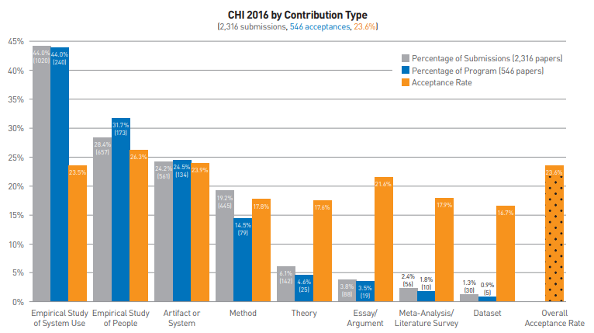
What’s the distribution of contribution types in a typical conference?
72% Empirical
24% Constructive
?19% Methods?

Slide 41
In summary
Wobbrock’s bottom-up approach
O&H’s top-down approach
Pros: matches well with paper submission, data driven
Cons: relationship between categories unclear, lack of systematic understanding
Pros: systematic, with a clear purpose, better defines/explains HCI research
Cons: missing types, “forceful” magic number of 3

Slide 42
A revised classification that combines both approaches
It adopts the same definition from [O&H’16]: HCI research is defined as finding solutions to research problems that can improve our problem-solving capacity
The “scientific progress” of HCI

Slide 43
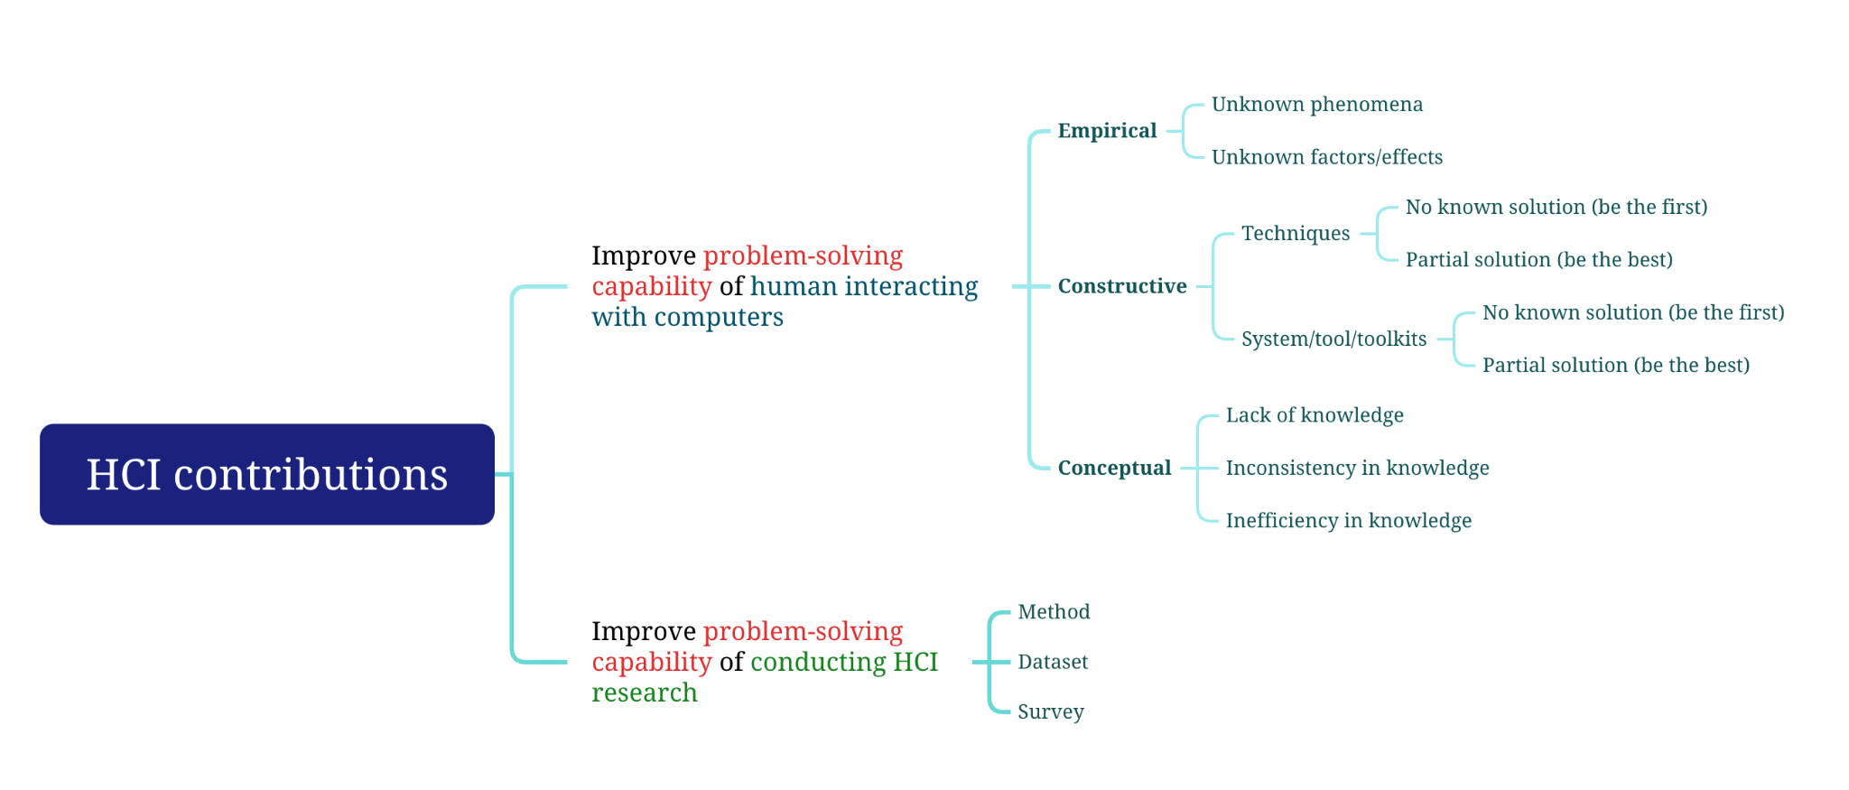
A revised classification that combines both approaches
Question: what about vision & opinion papers?

Slide 44
How to evaluate these contributions?
Three criteria
Originality
Significance
Validity
Five Aspects of Problem Solving Capacity
Significance
Effectiveness
Efficiency
Transfer
Confidence
No longer an explicit goal, yet to improve problem solving capacity, which includes originality
vs
Question: which evaluation criteria you should adopt for your paper?
Question: Does the contribution type of a paper affects how you evaluate it?

Slide 45
Interactive Time (5 mins)
Please go to Pollev.com/szhao168 (question 8, 9)

Slide 46
How many contributions does a paper usually have?
Typically many
Good literature review (conceptual contribution)
A good design space exploration (conceptual contribution)
Software architecture and implementation (constructive contribution)
Interface/interaction design (constructive contribution)
Field studies/interview to understand the problem space (empirical contribution)
Experiments to validate its effectiveness (empirical contribution)
Design implications (conceptual contribution)
Explain why using theoretical analysis (conceptual contribution)
Many good papers have a good literature review + a field study to understand the problem space + a good design space exploration + a design + implementation + experiments + design implications

Slide 47
How many contributions does a paper usually have?
However, there is only one main contribution
Many good papers have a good literature review + a field study to understand the problem space + a good design space exploration + a design + implementation + experiments + design implications
Question: what is the main contribution of the paper above?
Question: what does a conceptual-contribution-as-its-main-contribution paper look like?
Question: what does an empirical-contribution-as-its-main-contribution paper look like?

Slide 48



How reviewers evaluate the contribution of a paper?
Contributions in a paper
Acceptance threshold

Slide 49
Exercises & Discussion (20-30 mins)
Please compare your notes and briefly fill in the following sections

Slide 50
VRception: Rapid Prototyping of Cross-Reality Systems in Virtual Reality https://dl.acm.org/doi/abs/10.1145/3491102.3501821
What is this paper about?
Propose a new concept and system to support prototyping in a cross-reality context.
What research problem does this paper tries to solve?
How to prototype or collaborate with others in a cross-reality context effectively?
What is its main contribution to HCI?
Constructive contribution,a multi-user toolkit for cross-reality systems; rapid prototyping in VR without hardware expenses or physical prototyping skills
Are there any secondary contributions? If there are, what are they?
conceptual contribution, proposing VRception, a concept to simulate different realities in Virtual Reality
empirical contributions to understanding how humans interact with the proposed system and their feedback.
Notes:
P1

Slide 51
False positive vs false negative https://dl.acm.org/doi/abs/10.1145/3472749.3474735?cid=81414608731
What is this paper about?
This paper is a empirical research on investigates user preferences for false positives and false negatives in input recognition systems. It explores how the temporal cost of error recovery and cognitive load affect user experience.
What research problem does this paper tries to solve?
This paper addresses the challenge of optimizing input recognition systems by investigating how users perceive and are affected by false positive versus false negative errors, aiming to inform more dynamic and context-aware approaches to setting error trade-offs.
What is its main contribution to HCI?
conceptual contribution： Clusters of error occurrences, known as "peak effects," and the type of error experienced at the end of a task block, known as "end effects," can influence users' preferences for error types when reflecting on their experience.
Are there any secondary contributions? If there are, what are they?
Empirical contribution：The bias against false positive errors is in-part driven by the attentional demands of noticing when false positive errors have occurred.
temporal cost is not the sole driver of error preference.
Notes:
P1

Slide 52
Do We Need a Faster Mouse? Empirical Evaluation of Asynchronicity-Induced Jitter https://dl.acm.org/doi/abs/10.1145/3472749.3474783
What is this paper about?
Article on the unstable response due to asynchronicity between input and output signal frequencies, i.e. jitter, and the impact of this jitter on human performance.
What research problem does this paper tries to solve?
How asynchrony between input and output devices affects the user's perceived experience and task performance, and the extent to which this effect is perceptible.
What is its main contribution to HCI?
The main contribution of this paper HCI is the empirical contribution. The study provides insights into the perceptual threshold of jitter for human side and recommends display and mouse combinations that could minimize jitter effects based on the findings.
Are there any secondary contributions? If there are, what are they?
Theoretical Contribution：The paper defines the threshold at which jitter becomes noticeable to users, enhancing theoretical understanding in HCI.
Constructive Contribution(but it can be seen as test design format)：It provides actionable recommendations for hardware configurations to mitigate jitter effects, improving user experience in interactive systems.
Notes:
P1

Slide 53
What Kinds of Experiences Do You Desire? A Preliminary Study of the Desired Experiences of Contributors to Location-Based Mobile Crowdsourcing https://dl.acm.org/doi/10.1145/3491101.3519744
What is this paper about?
The paper investigates the types of location-related information desired by users of mobile crowdsourcing platforms as well as the characteristics of the information.
What research problem does this paper tries to solve?
1. The key characteristics of the location-related information available from these platforms.
2. The aspects of information quality that information seekers care about the most.
3. The kinds of experience information seekers expect or desire information contributors to possess.
What is its main contribution to HCI?
Conceptual contribution of the types and characteristics of the information that location-based mobile crowdsourcing contributors desire.
Are there any secondary contributions? If there are, what are they?
The follow-up application should be utilize a survey study and a theory of user preferences and perceptions
Data-driven insights: provide date related to the location, desired information, contribution experience.

Slide 54
Rapido: Prototyping Interactive AR Experiences through Programming by Demonstration https://dl.acm.org/doi/10.1145/3472749.3474774
What is this paper about?
The paper introduced a novel AR prototyping tool, Rapido, and how we could use it to turn a video prototype into an executable state machine through Pbd.
What research problem does this paper tries to solve?
There is a need for authoring tools that do not rely in codes to allow non-programmers to prototype nre AR ideas.
What is its main contribution to HCI?
Constructive study: a method that enables designers to turn a video prototype into an executable state machine using Programming by Demonstration (PbD).
Are there any secondary contributions? If there are, what are they?
Conceptual? An illustration of the the power of Rapido’s approach by prototyping the main interactions of three popular AR mobile applications.
Notes:
P1

Slide 55
“I Don't Even Remember What I Read”: How Design Influences Dissociation on Social Media https://dl.acm.org/doi/10.1145/3491102.3501899
What is this paper about?
Paper talks about “dissociating” from what one has said due to constantly being online and getting fed so much data daily.
What research problem does this paper tries to solve?
Understanding if users actually enter a flow state and “daydream” while scrolling through social media
What is its main contribution to HCI?
Conceptual Contribution - understanding if there is a dissociation
Are there any secondary contributions? If there are, what are they?
Constructive Contribution - due to design experiments

Slide 56
What is interaction? https://dl.acm.org/doi/10.1145/3025453.3025765
What is this paper about?
Define "interaction" and proven the importance of stop misusing the term
What research problem does this paper tries to solve?
Do we have an undefined and descriptive properties of "interaction"
What is its main contribution to HCI?
The main contribution of the paper is the extraction and analysis of distinct concepts of interaction from existing HCI literature. It identifies seven concepts of interaction: dialogue, transmission, optimal behavior, embodiment, tool use, experience, and control. stop the deviation of "interaction" create concrete fundamentals for the term "interaction"
Are there any secondary contributions? If there are, what are they?
empirical (deviation in word usage of "interaction")
future work on interaction, emphasizing the need to improve scope and specificity, to better account for the effects and agency that computers have in interaction, and to generate strong propositions about interaction.
Notes:
P1

Slide 57
Computational Rationality as a Theory of Interaction https://dl.acm.org/doi/abs/10.1145/3491102.3517739
What is this paper about?
talk about How do people interact with computers / how information is processed in the mind
talk about how do people adapt their interaction to the limits imposed by cognition, device design, and environment
What research problem does this paper tries to solve?
Develop the argument that human adaptation is of general interest to the field of HCI
Implications for Modeling Human Behavior
Provide a unified framework for defining a broad range of computationally rational models, focusing on integrating cognitive bounds into RL-based models of interaction
The paper addresses the fundamental question of how people interact with computers. Specifically, it aims to reframe this question from being about human cognition to being about human adaptation. The authors seek to understand how users adapt their interactions in response to the limits imposed by their cognitive architecture, device design, and the environment. This involves developing models that can explain and predict user behavior in various HCI contexts.
What is its main contribution to HCI?
Are there any secondary contributions? If there are, what are they?
Notes:
1.What is this paper about?
talk about How do people interact with computers / how information is processed in the mind
talk about how do people adapt their interaction to the limits imposed by cognition, device design, and environment
2.What research problem does this paper tries to solve?
how do people adapt their interaction to the limits imposed by cognition, device design, and environment
Develop the argument that human adaptation is of general interest to the field of HCI
Implications for Modeling Human Behavior
Provide a unified framework for defining a broad range of computationally rational models, focusing on integrating cognitive bounds into RL-based models of interaction
The paper addresses the fundamental question of how people interact with computers. Specifically, it aims to reframe this question from being about human cognition to being about human adaptation. The authors seek to understand how users adapt their interactions in response to the limits imposed by their cognitive architecture, device design, and the environment. This involves developing models that can explain and predict user behavior in various HCI contexts.
3.What is its main contribution to HCI?
Conceptual - Framework development, Literature review, Behavior understanding
A THEORY: The paper reviews the theoretical commitments and emerging applications in HCI, and it concludes by outlining a research agenda for future work.
4.Are there any secondary contributions? If there are, what are they?
Behavior Understanding

Slide 58
Summary of HCI contributions

Slide 59
Summary of HCI contributions
Three criteria
Originality
Significance
Validity
Five Aspects of Problem Solving Capacity
Significance
Effectiveness
Efficiency
Transfer
Confidence
No longer an explicit goal, yet to improve problem solving capacity, which includes originality
vs
Question: which evaluation criteria you should adopt for your paper?

Slide 60
Q&A and Discussions

Slide 61
Paperthon Introduction
https://docs.google.com/document/d/19CuzjUQ6_cxvSQtM2AK4LehUZWkT8qPRBFPJWmCuTj8/edit

Slide 62
Brainstorming & Team formation

Slide 63

End of Day Survey
https://forms.gle/rb3RbTuAQvGqiBdA8

